Slide 1

Deep Image Compression using Decoder Side Information
Deep Image Compression using Decoder Side Information
Sharon Ayzik & Shai Avidan
A presentation by:
Arian Tashakkor

Slide 2
Deep-DSIC
Problem Statement
Shifting complexity to decoder-side.
Proposed Method
Using a decoder-side-only compensator combined with an Autoencoder to represent more with less!
Results and Comparisons
with other state-of-the-art methods.
Q&A

Slide 3
Problem Statement
Consider the following use cases:
A group of people in an event that upload their pictures of the gathering to an online cloud-based service. These pictures are likely highly correlated although taken at different time steps and with a spatial shift.
An image pair from an stereoscopic camera. The image from each camera is stored independently although there is a high degree of correlation between the two.

Slide 4
Problem Statement (Cont’d)
We could make it so that in either use case, the encoder (edge devices in case No. 1 and each of the left and right cameras in case No. 2) uses this correlation in order to compress further compress the results.
Problem:
Increased load on encoder side while it is more desirable to have the decoder undertake this extra complexity.
Can we somehow shift this load to the decoder-side only without enforcing extra load on the encoder?

Slide 5
Proposed Method
Distributed Source Coding (DSC) tells us that “it is indeed possible to encode a source X given a correlated source Y even if Y is only available to the decoder side.”
General idea:
Break both images into patches.
Use these patches to measure the correlation between the images.

Slide 6
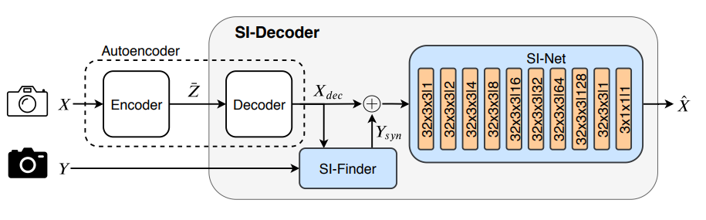
Proposed Method: Architecture

Slide 7

Proposed Method: Breakdown
Image $X$ (reference) is encoded to latent representation $\overline{Z}$ and then decoded to $X_{dec}$.
$X_{dec}$along with $Y$ are used to construct $Y_{syn}$.
$X_{dec}$ and $Y_{syn}$ are combined and forwarded to the SI-Net block that outputs the final reconstruction, $\hat{X}$.

Slide 8
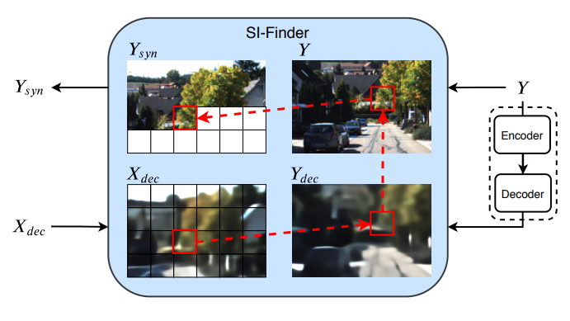
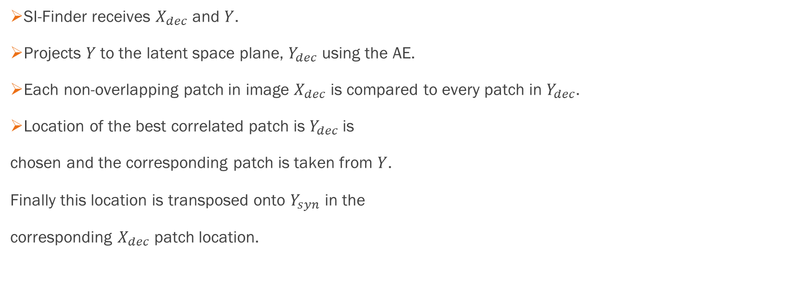
Proposed Method: SI-Finder
SI-Finder receives $X_{dec}$ and $Y$.
Projects $Y$to the latent space plane, $Y_{dec}$ using the AE.
Each non-overlapping patch in image $X_{dec}$ is compared to every patch in $Y_{dec}$.
Location of the best correlated patch is $Y_{dec}$is
chosen and the corresponding patch is taken from $Y$.
Finally this location is transposed onto $Y_{syn}$ in the
corresponding $X_{dec}$ patch location.

Slide 9
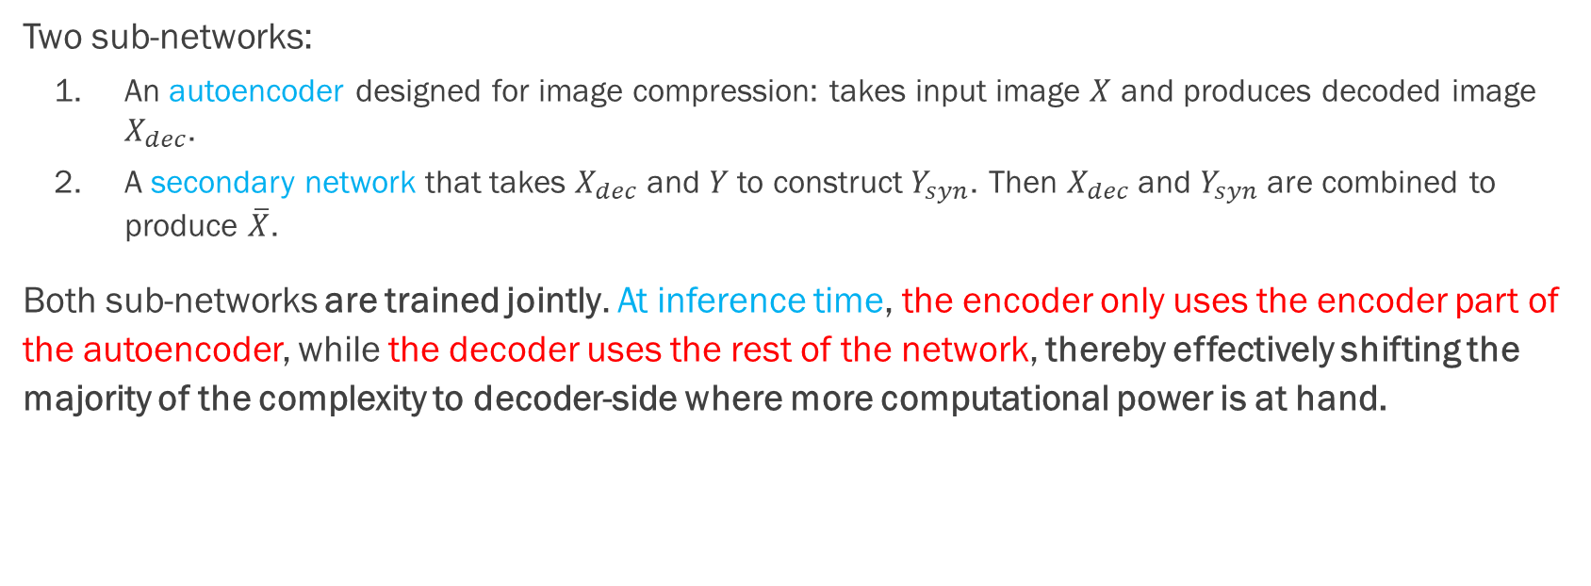
Proposed Method: Training & Inference
Two sub-networks:
An autoencoder designed for image compression: takes input image $X$ and produces decoded image $X_{dec}$.
A secondary network that takes $X_{dec}$ and $Y$ to construct$Y_{syn}$. Then $X_{dec}$ and $Y_{syn}$are combined to produce $\overline{X}$.
Both sub-networks are trained jointly. At inference time, the encoder only uses the encoder part of the autoencoder, while the decoder uses the rest of the network, thereby effectively shifting the majority of the complexity to decoder-side where more computational power is at hand.

Slide 10
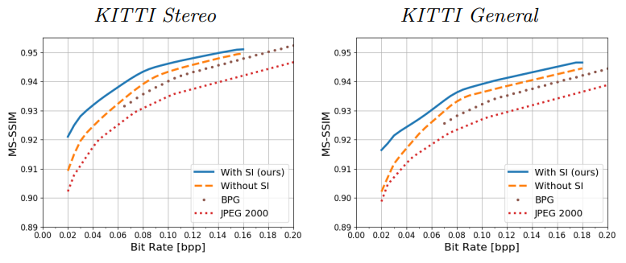
Results and Comparisons
Metric used for comparison is MS-SSIM (MultiScale-Structural Similarity Index Measure), a metric that is said to better represent human perception of distortion than MSE and PSNR, especially in cases where distortion is large.

Slide 11
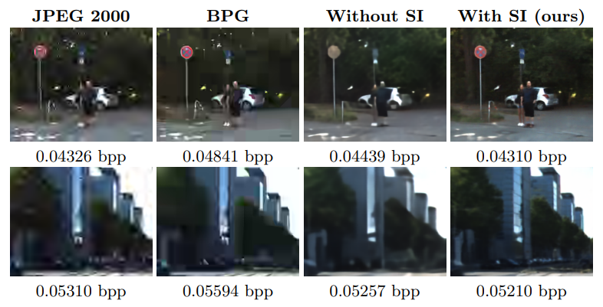
Results and Comparisons (Cont’d)

Slide 12
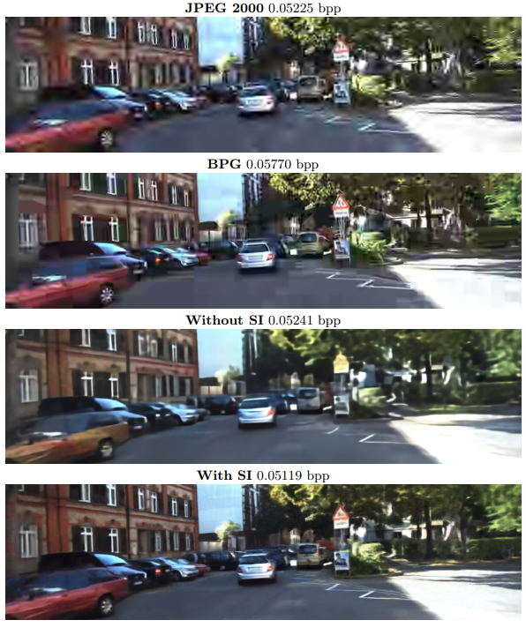
Results and Comparisons (Cont’d)

Slide 13
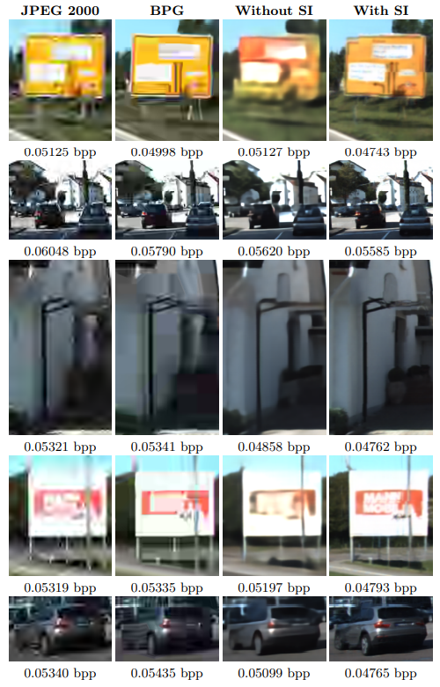
Results and Comparisons (Cont’d)
The authors’ experiments show that “using decoder-only side information can help reduce communication bandwidth by anywhere between 10% and 50%, depending on distortion level and the correlation between the side information image and the reference image.”

Slide 14
Q&A
Thank you for your attention.
Please feel free to ask any questions you might have.

Slide 15
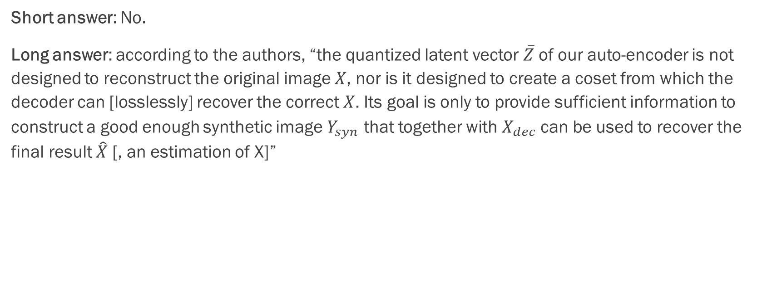
Q: Can this do Lossless Compression?
Short answer: No.
Long answer: according to the authors, “the quantized latent vector $\overline{Z}$ of our auto-encoder is not designed to reconstruct the original image $X$, nor is it designed to create a coset from which the decoder can [losslessly] recover the correct $X$. Its goal is only to provide sufficient information to construct a good enough synthetic image $Y_{syn}$ that together with $X_{dec}$ can be used to recover the final result $\hat{X}$ [, an estimation of X]”

Slide 16
Q: Why not apply this to video compression?
Answer: because the side information (which would be the previous frame in the case of a vide) is known both to the encoder as well as the encoder. If side information is already available then we should not purposefully sabotage image quality by not using it in the encoder. Here we consider images that are taken by different cameras at slightly different time steps, which means using side information comes at the cost of bandwidth.

Slide 17
Q: What is DSC?
Answer: [According to Wikipedia] Distributed source coding (DSC) is an important problem in information theory and communication. DSC problems regard the compression of multiple correlated information sources that do not communicate with each other. By modeling the correlation between multiple sources at the decoder side together with channel codes, DSC is able to shift the computational complexity from encoder side to decoder side, therefore provide appropriate frameworks for applications with complexity-constrained sender, such as sensor networks and video/multimedia compression (see distributed video coding). One of the main properties of distributed source coding is that the computational burden in encoders is shifted to the joint decoder.

Slide 18
Q: Why not assume the two images are aligned? Match every single pixel instead of patches.
Answer: Because the authors are attempting to solve the problem for the case where the spatial and temporal shifts eliminate the alignment to a very high extent. For example, “we would like two images containing a house next to a tree to be correlated even if the tree is to the right of the house in one image, and is to the left in the other.”

Slide 19
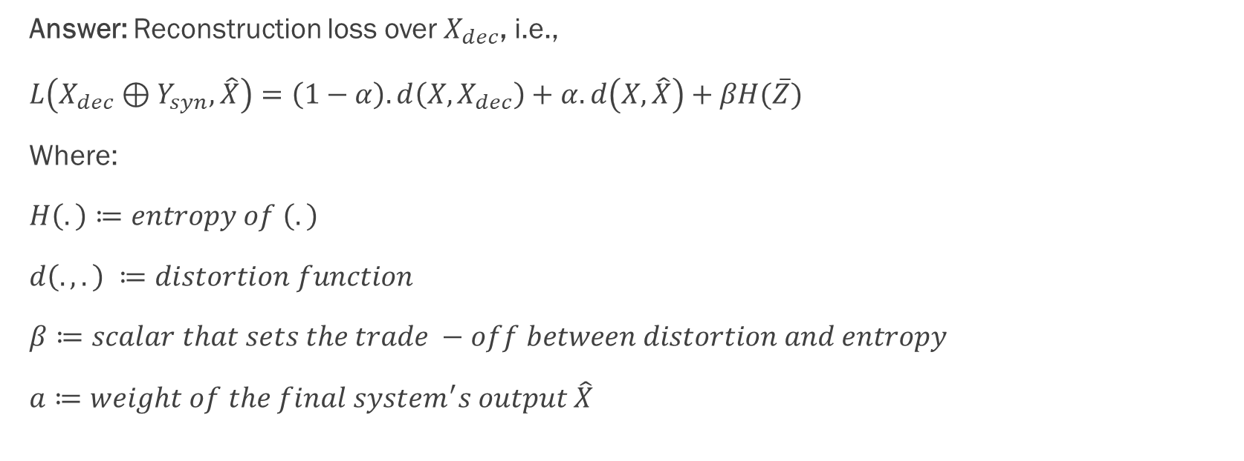
Q: Loss function of the SI-Net block?
Answer: Reconstruction loss over $X_{dec}$, i.e.,
$L\left(X_{dec}⊕Y_{syn}, \hat{X}\right)=\left(1−α\right).d\left(X, X_{dec}\right)+α.d\left(X, \hat{X}\right)+βH(\overline{Z})$
Where:
$H\left(.\right)≔entropy of \left(.\right)$
$d\left(., .\right) ≔distortion function$
$β≔scalar that sets the trade −off between distortion and entropy$
$a≔weight of the final system^{′}s output \hat{X}$

Slide 20
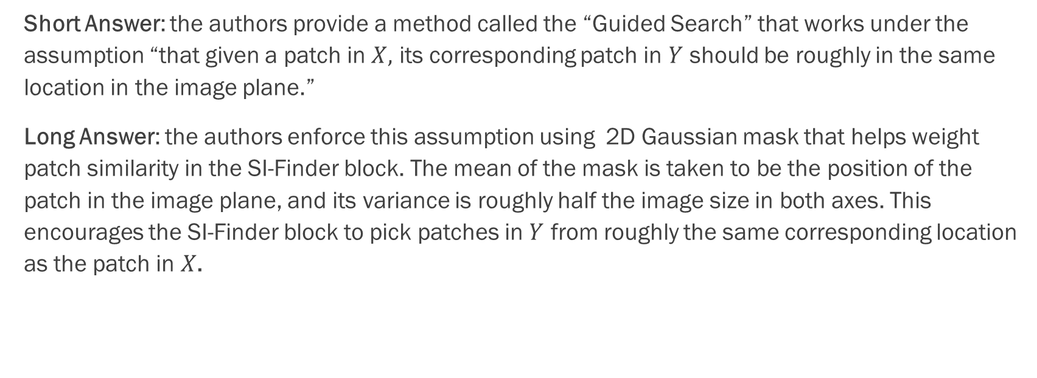
Q: How does SI-Finder perform its matching?
Short Answer: the authors provide a method called the “Guided Search” that works under the assumption “that given a patch in $X,$ its corresponding patch in $Y$ should be roughly in the same location in the image plane.”
Long Answer: the authors enforce this assumption using 2D Gaussian mask that helps weight patch similarity in the SI-Finder block. The mean of the mask is taken to be the position of the patch in the image plane, and its variance is roughly half the image size in both axes. This encourages the SI-Finder block to pick patches in $Y$ from roughly the same corresponding location as the patch in $X$.

